Slide 1
Developing Class Diagrams

Slide 2
Class Diagram: UML
What is UML?
Why should I bother?
Do people really use UML?
What is a UML class diagram?
What kind of information goes into it?
How do I create it?
When should I create it?

Slide 3
Class Diagram: UML
Design: specifying the structure of how a software system will be written and function, without actually writing the complete implementation
A transition from “what” the system must do, to “how” the system will do it.
What classes will we need to implement a system that meets the requirements?
What fields and methods will each class have?
How will the classes interact with each other?

Slide 4
How do we design classes
Class identification from project spec/ requirements
Nouns are potential classes, objects, fields
Verbs are potential methods or responsibilities of a class
CRC card exercises
Write down classes’ names on index cards
Next to each class, list the following:
Responsibilities: problems to be solved: short verb phrases
Collaborators: other classes that are sent messages by this class (asymmetric)

Slide 5
What is UML?
UML: pictures of an OO system
Programming languages are not abstract enough for OO design
UML is an open standard; lots of companies use it

Slide 6
Uses for UML?
As a sketch: to communicate aspects of system
Forward design: doing UML before coding
Backward design: doing UML after coding as documentation
Often done on whiteboard or paper
As a blue print: a complete design to be implemented
Some times done with CASE ( Computer-Aided Software Engineering) tools

Slide 7
Uses for UML?
As a programming language: with the right tools, code can be auto-generated and executed from UML
Only good if this is faster than coding in a “real” language

Slide 8
UML class diagram
UML class diagram: a picture of
The classes in an OO system
Their fields and methods
Connections between the classes
That interact or inherit from each other

Slide 9
UML class diagram
Not represented in a UML class diagram:
Details of how the classes interact with each other
Algorithmic details; how a particular behaviour is implemented

Slide 10
Class Diagram: Class Symbol
A Class is “a description of a set of objects with similar features, semantics and constraints” (OMG, 2009)
Class name compartment
Client
companyAddress
Attributes compartment
companyEmail
companyFax
companyName
companyTelephone
Operations compartment

Slide 11
Class Diagram: Instances
An object (instance) is: “an abstraction of something in a problem domain…”
Object name compartment
FoodCo:Client
companyAddress=Evans Farm, Norfolk
companyEmail=mail@foodco.com
Attribute values
companyFax=01589-008636
companyName=FoodCo
companyTelephone=01589-008638
Instances do not have operations

Slide 12
Class Diagram: Attributes
Attributes are:
Part of the essential description of a class
The common structure of what the class can ‘know’
Each object has its own value for each attribute in its class:
Attribute=“value”
companyName=FoodCo

Slide 13
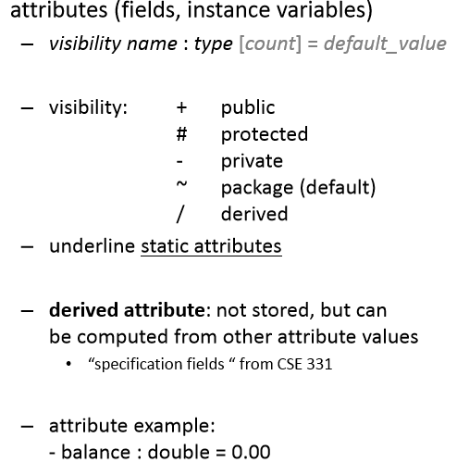
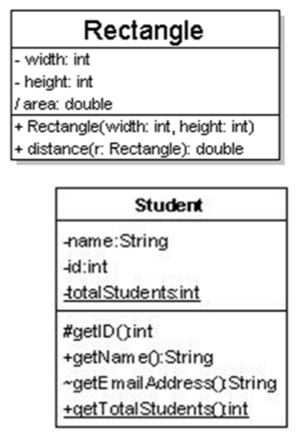
Class Diagram: Attributes

Slide 14
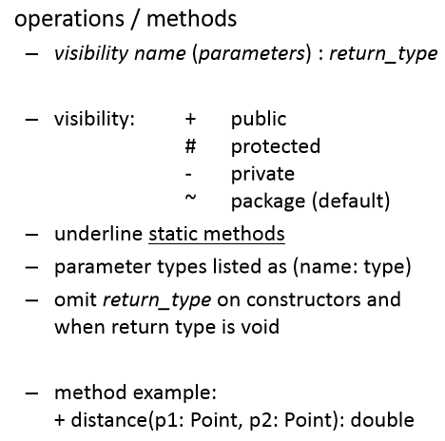
Class Diagram: Attributes

Slide 15
Relationship between classes

Slide 16
Class Diagram: Associations
Associations represent:
The possibility of a logical relationship or connection between objects of one class and objects of another
“Grace Chia is the staff contact for FoodCo”
An employee object is linked to a client object
If two objects are linked, their classes are said to have an association

Slide 17
Class Diagram: Associations
Association
Association role
Client
StaffMember
staffContact
companyAddress
staffName
companyEmail
staffNo
liaises with
companyFax
staffStartDate
companyName
companyTelephone
Association name
Direction in which name should be read

Slide 18
Class Diagram: Multiplicity
Associations have multiplicity: the range of permitted cardinalities of an association
Represent enterprise (or business) rules
These always come in pairs:
Associations must be read separately from both ends
Each bank customer may have 1 or more accounts
Every account is for 1, and only 1, customer

Slide 19
Mulitiplicity values
Indicator | Meaning
0..1 | Zero or one
1 | One only
0..* | Zero or more
* | Zero or more
1..* | One or more
3 | Three only
5..10 | Five to ten

Slide 20
Class Diagram: Multiplicity
Multiplicities
Client
StaffMember
companyAddress
staffName
1
0..*
companyEmail
staffNo
companyFax
liaises with
staffStartDate
companyName
companyTelephone
Exactly one staff member liaises with each client
A staff member may liaise with zero, one or more clients

Slide 21
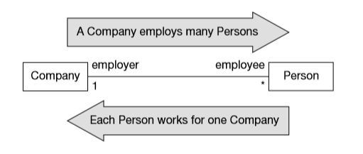
Class Diagram: Multiplicity
This example shows how to evaluate multiplicity rules.

Slide 22
Class Diagram: Operations
Operations are:
An essential part of the description of a class
The common behaviour shared by all objects of the class
Services that objects of a class can provide to other objects

Slide 23
Class Diagram: Operations
Operations describe what instances of a class can do:
Set or reveal attribute values
Perform calculations
Send messages to other objects
Create or destroy links
Campaign
actualCost
campaignFinishDate
campaignStartDate
completionDate
datePaid
estimatedCost
title
checkCampaignBudget ( )
getCampaignContribution ( )
recordPayment ( )
setCompleted ( )

Slide 24
Associations
How the classes (objects) will be related to each other.
There are five type of associations:
Bi-directional
Uni-directional
Basic Aggregation
Composition Aggregation
Reflexive associations

Slide 25
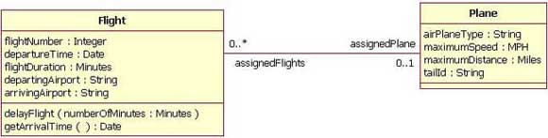
Bi-directional Association
This is a standard association between two classes.
This means that both classes are aware of each other and their relationship.
The following diagram shows an association between a Flight and Plane class:

Slide 26
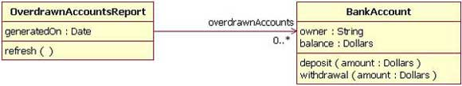
Uni-directional Association
In this association, two classes are related but only one class knows that the relationship exists.
The following figure shows an example of overdrawn account’s report with a uni-directional association.

Slide 27

Basic Aggregation
As association with an aggregation relationship indicates that one class is a part of another class.
To represent an aggregation relationship, you draw a solid line from the parent class to the part class, and draw an unfilled diamond shape on the parent class’s association end.
The figure shows an example of an aggregation relationship between Car and a Wheel.

Slide 28

Composition Aggregation
In composition aggregation, the child class’s instance lifecycle is dependent on the parent class’s instance lifecycle.
This relationship is drawn like the basic aggregation but with the filled diamond.
The figure shows a composition relationship between a Company class and a Department class.
In this when Company instance is removed or destroyed, the Deptartment instance is automatically removed or destroyed.

Slide 29
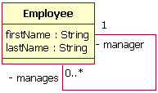
Reflexive Associations
The classes can be associated with itself, using a reflexive association.
The figure shows how an Employee class could be related to itself through the manager/manages role.

Slide 30
Generalization
Indicates that objects of specialized class (subclass) are substitutable for objects of generalized class (super class)
“is a kind of” relationship

Slide 31
Generalization
A subclass inherits from its super class:
Attributes
Operations
Relationship
A subclass may
Add attributes and operations
Add relationships
Refine (override) inherited operations

Slide 32
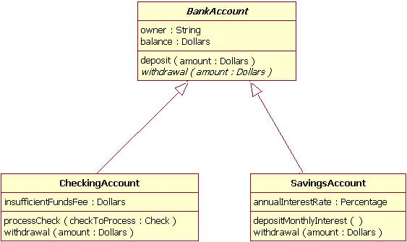
Generlaization/Inheritance Example

Slide 33
Complete the Association
Engine
Driver
Automobile
Truck
Wheel

Slide 34
Resources
Aggregation and Composition Association and multiplicity:
https://www.youtube.com/watch?v=X9yvOl4Ywew

Slide 35
Question?

